Slide 1
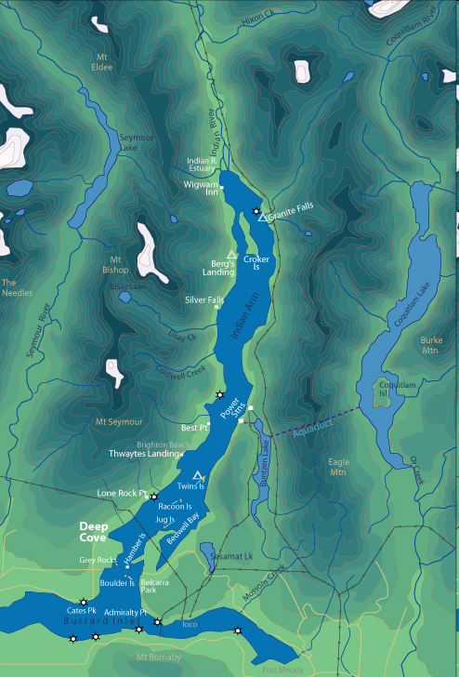

Slide 2
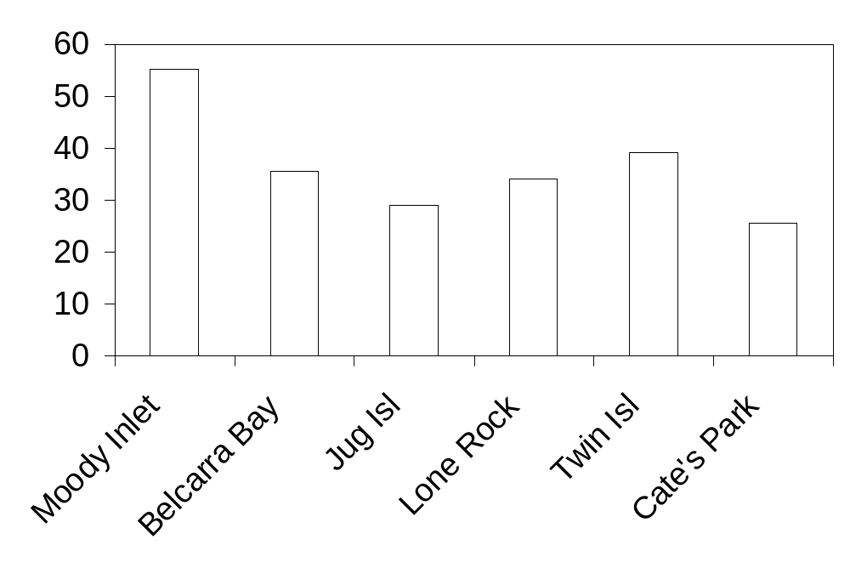
Seastar diameter (cm)
64
40
35
80
9
80

Slide 3
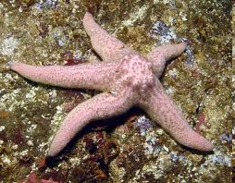
Spiny pink seastar Pisaster brevispinus survey
near Reed Point Marina 15 November 2010
15
Mean: 55.3 cm
SD: 12.4 cm
N = 64
10
Frequency
Published
max length
5
Record length at Reed Point
20
40
60
80
100
Length across

Slide 4
Spiny pink seastar Pisaster brevispinus
15
Mean: 55.3 cm
SD: 12.4 cm
N = 64
Moody
Inlet
Jug
Island
Mean: 28.9 cm
SD: 8.7 cm
N = 38
10
Frequency
Published
max length
5
Record length at Reed Point
20
40
60
80
100
Diameter (cm)

Slide 5
Spiny pink seastar Pisaster brevispinus
15
Mean: 55.3 cm
SD: 12.4 cm
N = 64
Moody
Inlet
10
Frequency
Published
max length
5
Record length at Reed Point
20
40
60
80
100
Diameter (cm)

Slide 6
Spiny pink seastar Pisaster brevispinus
15
Jug
Island
Mean: 28.9 cm
SD: 8.7 cm
N = 38
10
Frequency
5
Published
max length
Record length at Reed Point
20
40
60
80
100
Diameter (cm)

Slide 7
Spiny pink seastar Pisaster brevispinus
Belcarra
Bay
Mean: 35.5 cm
SD: 10.5 cm
N = 40
15
10
Frequency
5
Published
max length
Record length at Reed Point
20
40
60
80
100
Diameter (cm)

Slide 8
Spiny pink seastar Pisaster brevispinus
Twin
Islands
Mean: 39.1 cm
SD: 9.0 cm
N = 9
15
10
Frequency
5
Published
max length
Record length at Reed Point
20
40
60
80
100
Diameter (cm)

Slide 9
Spiny pink seastar Pisaster brevispinus
21
21
Mean: 34.1 cm
SD: 6.4 cm
N = 80
Lone
Rock
15
10
Frequency
5
Published
max length
Record length at Reed Point
20
40
60
80
100
Diameter (cm)

Slide 10
Spiny pink seastar Pisaster brevispinus
19
Mean: 25.6 cm
SD: 7.9 cm
N = 57
Cate’s
Park
15
10
Frequency
5
Published
max length
Record length at Reed Point
20
40
60
80
100
Diameter (cm)

